Slide 1
Loops in C Programming
Md. Alamgir Hossain
Lecturer,
Dept. of CSE, Prime University
Mail: alamgir.cse14.just@gmail.com

Slide 2
Loops
You may encounter situations, when a block of code needs to be executed several number of times.
A loop statement allows us to execute a statement or group of statements multiple times.
C programming has three types of loops:
for loop
while loop
do...while loop

Slide 3
for Loop
The syntax of the for loop is:
for (initializationStatement; test/conditional Expression; update/iteration/ inc or dec statement)
{
// statements inside the body of loop
}

Slide 4
How for Loop works??
The initialization statement is executed only once.
Then, the test expression is evaluated. If the test expression is evaluated to false, the for loop is terminated.
However, if the test expression is evaluated to true, statements inside the body of for loop are executed, and the update expression is updated.
Again the test expression is evaluated.
This process goes on until the test expression is false. When the test expression is false, the loop terminates.

Slide 5
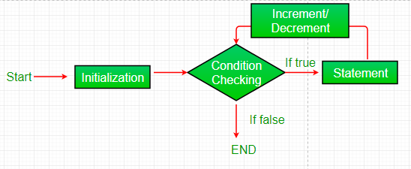
Flowchart of for Loop

Slide 6
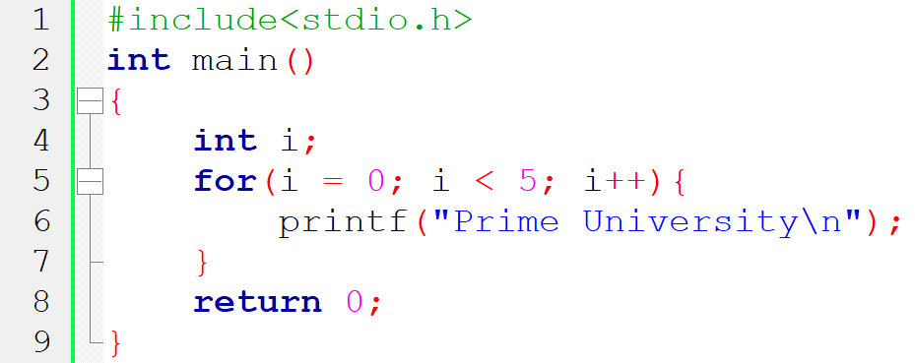
Example using for Loop

Slide 7
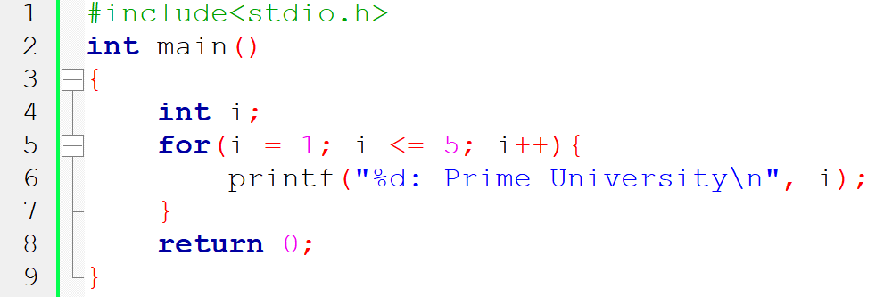
Example using for Loop

Slide 8
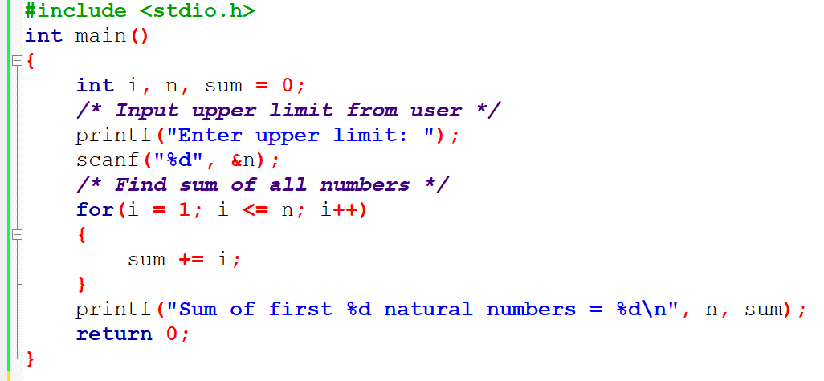
Program to find sum of natural numbers from 1 to n

Slide 9
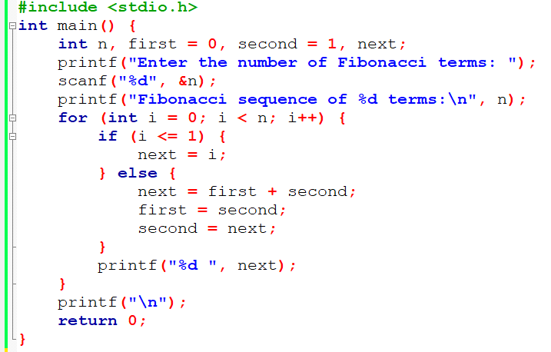
C program to print the first n terms of the Fibonacci sequence

Slide 10
while Loop
The syntax of the while loop is:
while (testExpression)
{
// statements inside the body of the loop
}

Slide 11
How while Loop works??
The while loop evaluates the test expression inside the parenthesis ().
If the test expression is true, statements inside the body of while loop are executed. Then, the test expression is evaluated again.
The process goes on until the test expression is evaluated to false.
If the test expression is false, the loop terminates (ends).

Slide 12
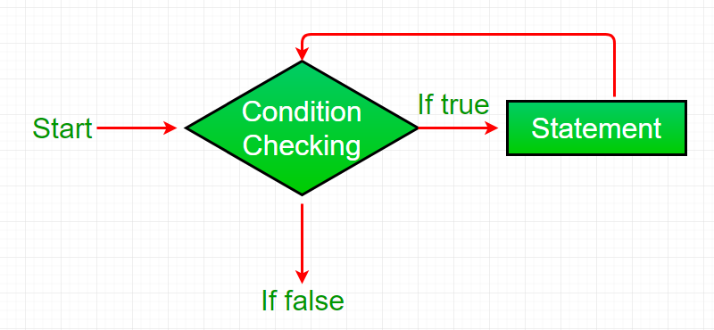
Flowchart of while Loop

Slide 13
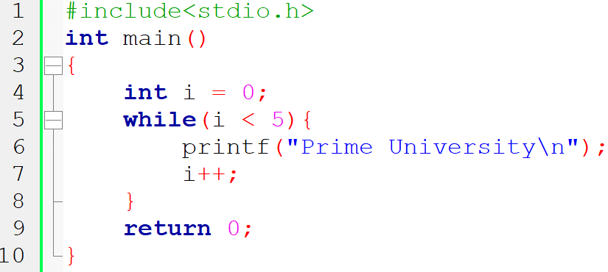
Example using while Loop

Slide 14
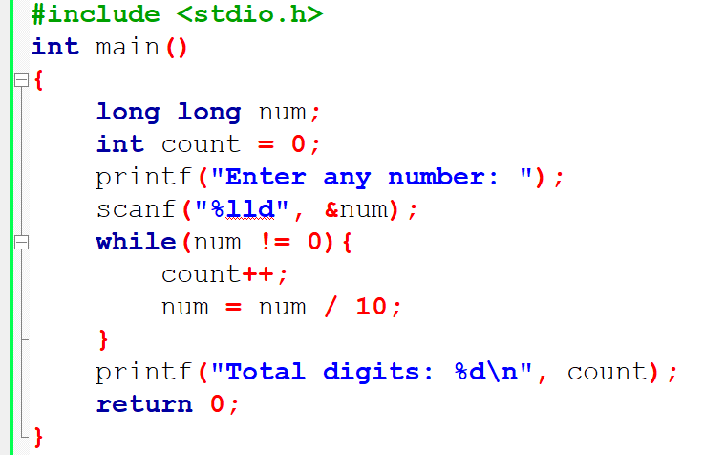
Program to count number of digits

Slide 15
Difference between for & while loop
For Loop | While Loop
If the condition is not put up in ‘for’ loop, then loop iterates infinite times. | If the condition is not put up in ‘while’ loop, it provides compilation error.
It is normally used when the number of iterations is known. | It is normally used when the number of iterations is unknown.
It is used when initialization and increment is simple. | It is used for complex initialization.

Slide 16
do-while Loop
The syntax of the while loop is:
do
{
// statements inside the body of the loop
}while(condition);

Slide 17
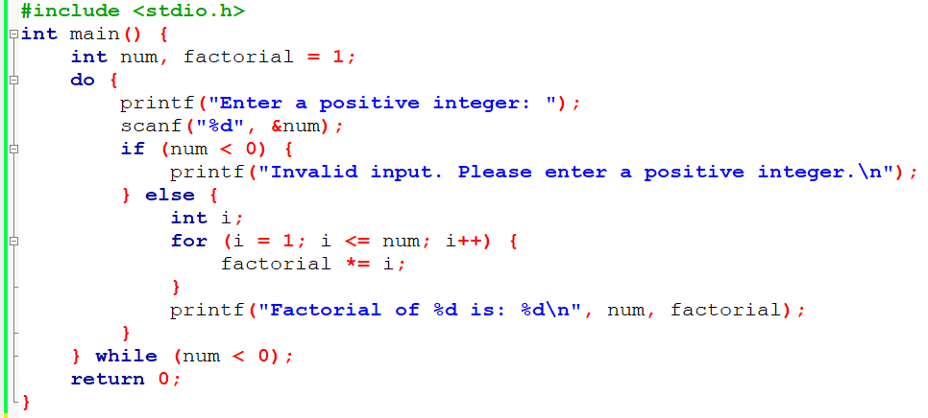
C program to calculate the factorial of a positive integer

Slide 18
Difference between while & do-while loop
While Loop | Do-While Loop
The while loop evaluates the condition first and then execute the statements. | The do-while loop execute the statements first before evaluating the condition.
The condition is specified at the beginning of the loop. | The condition isn’t specified until after the body of the loop.
The body is executed only is a certain condition is true. | The body is always executed at least once, if the condition is false.

Slide 19
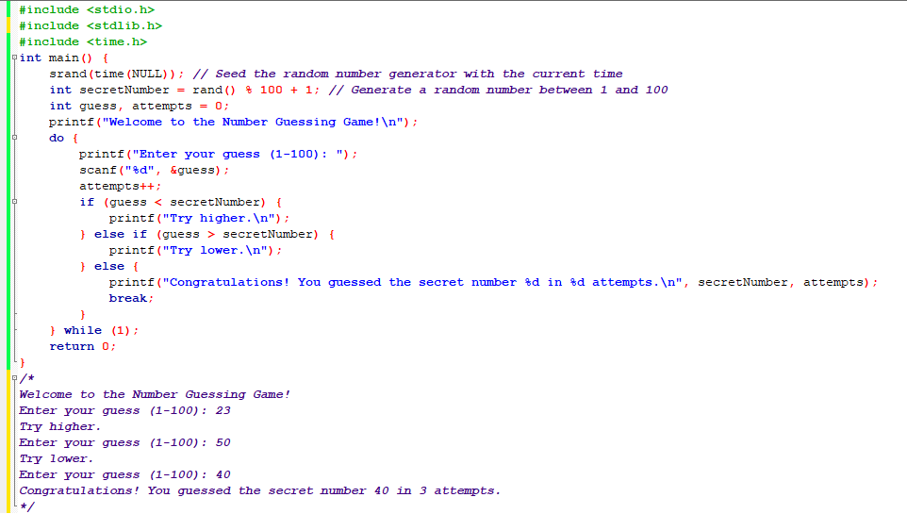

Slide 20
Homework
Write a C Program to find sum of natural numbers in given range.
Write a C program to find sum of all even numbers between 1 to n.
Write a C program to find sum of all odd numbers between 1 to n.
N.B: Use for, while and do-while loop.

Slide 21
Thank You

